Slide 1
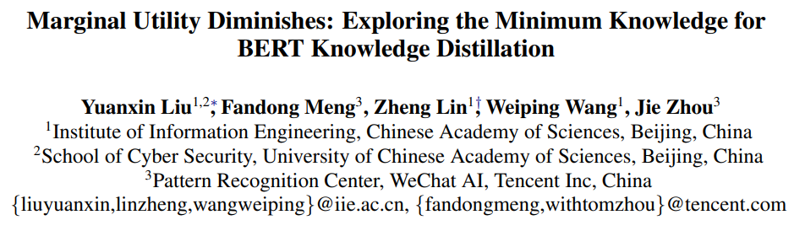
ACL2021

Slide 2
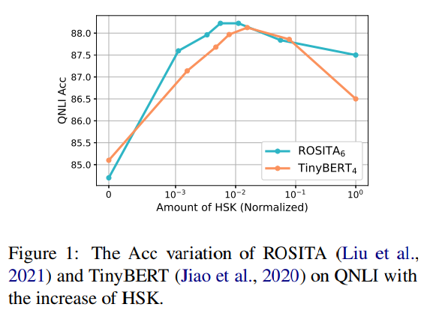
Motivation
Although distilling the teacher’s hidden state knowledge (HSK) is helpful, the performance gain (marginal utility) diminishes quickly as more HSK is distilled.
The student’s performance can be improved by extracting and distilling the crucial HSK.
Using a tiny fraction of HSK can achieve the same performance as extensive HSK distillation.

Slide 3


HSK Compression
the depth dimension: eliminating entire layers
the length dimension: dropping the representations corresponding to particular tokens
the width dimension: set the eliminated activations to zero

Slide 4
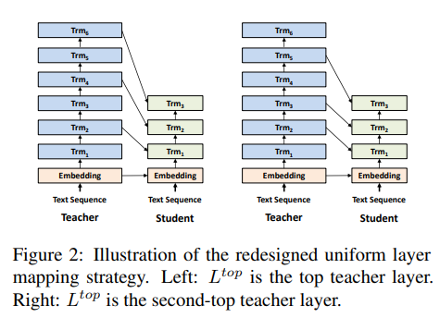



Depth Compression

Slide 5
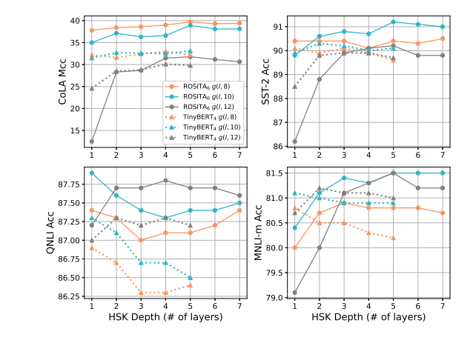
Depth Compression
1) For the g(l; 12) mapping function (the grey lines), depth compression generally has a negative impact on the students’ performance.
2)In terms of the g(l; 10) and g(l; 8) mapping functions (the blue and orange lines), HSK distillation with only one or two layers can achieve comparable performance as using all the L + 1 layers
3)This demonstrates that, the most crucial HSK does not necessarily reside in the top BERT layer, which reveals a potential way to improve HSK distillation of BERT.

Slide 6
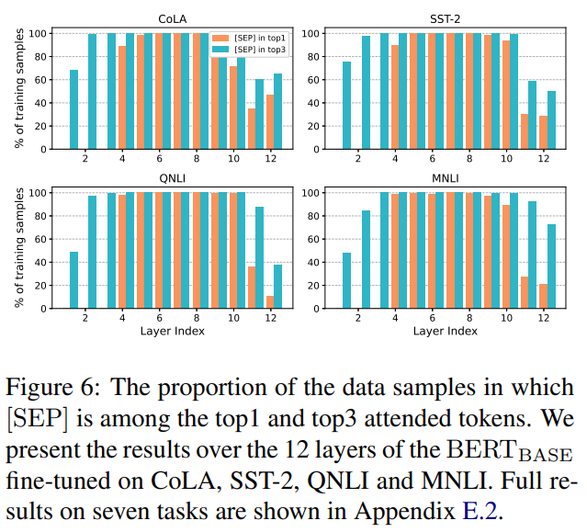
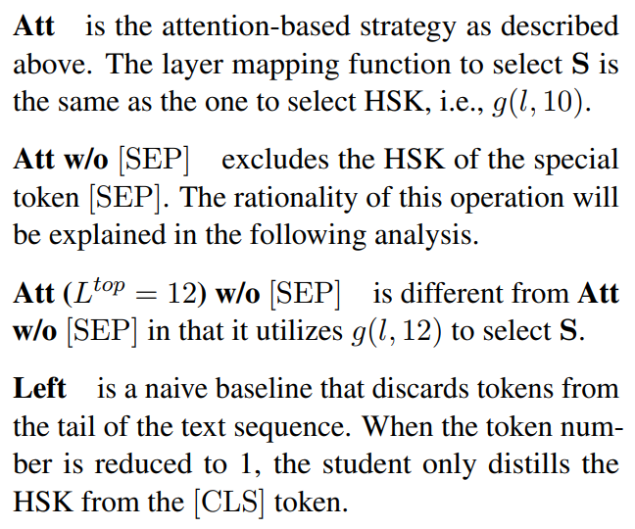
Length Compression

Slide 7
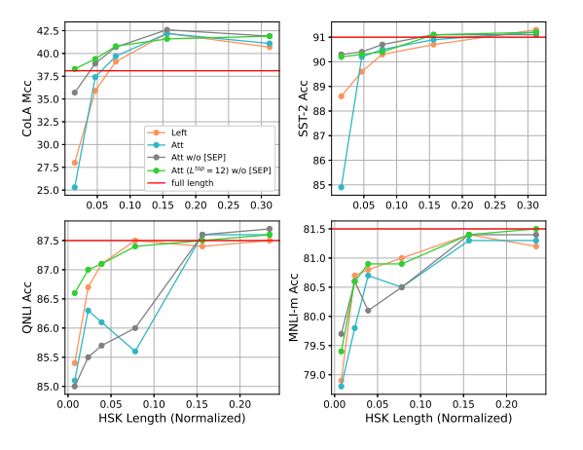
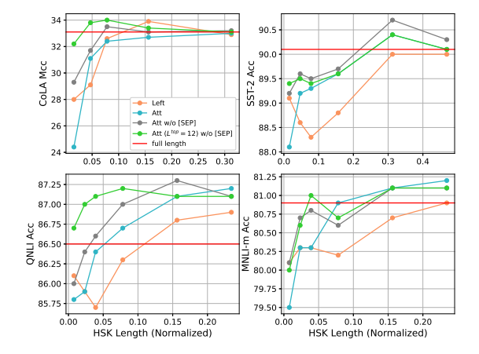
Length Compression

Slide 8
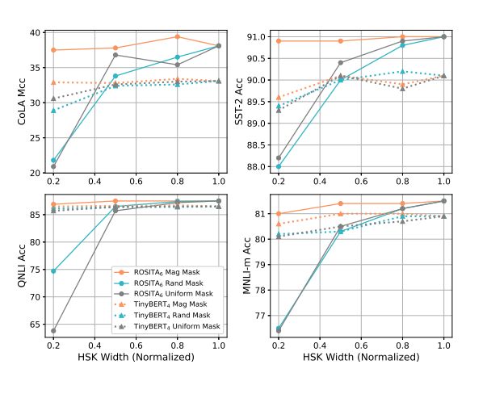
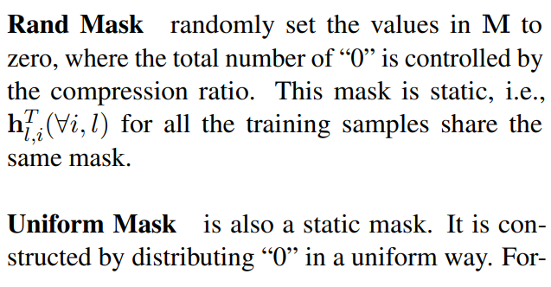
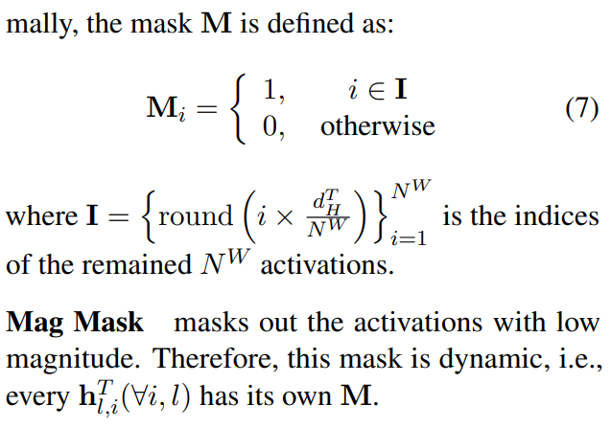


Width Compression

Slide 9
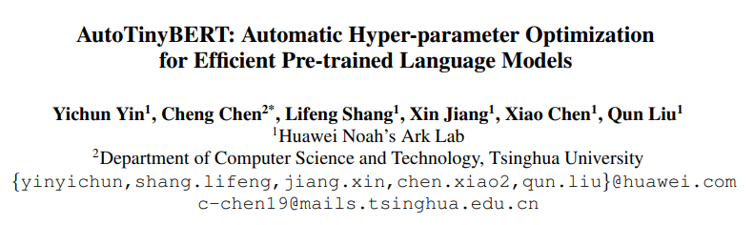
ACL2021
Can we find better settings of hyper-parameters for efficient PLMs?

Slide 10
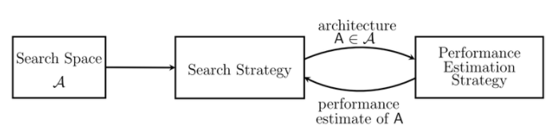
Brief Introduction of NAS

Slide 11

Problem Statement
Performance: dev-acc
Search Space
Model parameters
Model loss
Latency constraints

Slide 12
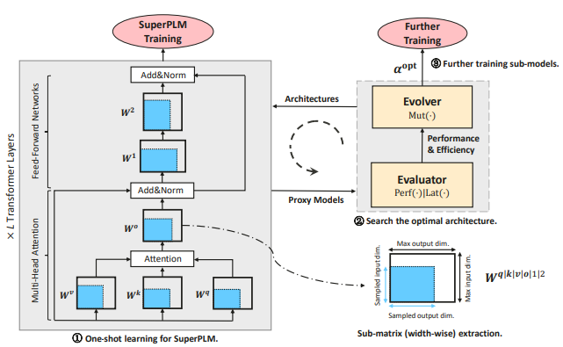
Overview
The proposed method includes three stages:
(1) the one-shot learning to obtain SuperPLM that can be used as the proxy for various architectures;
(2) the search process for the optimal hyper-parameters;
(3) the further training with the optimal architectures and corresponding sub-models.

Slide 13
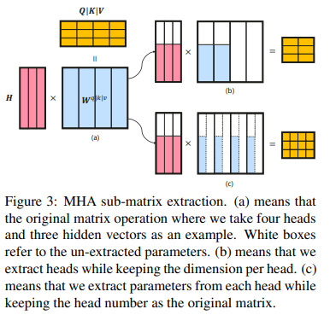




Search Space
Conventional hyper-parameter setting
The overall search space

Slide 14
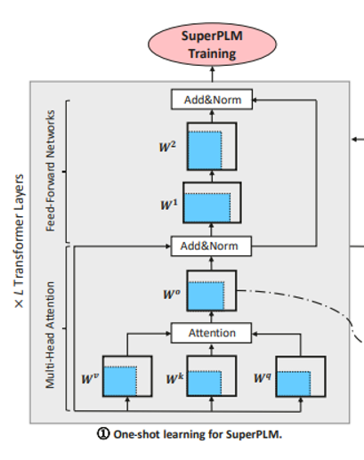
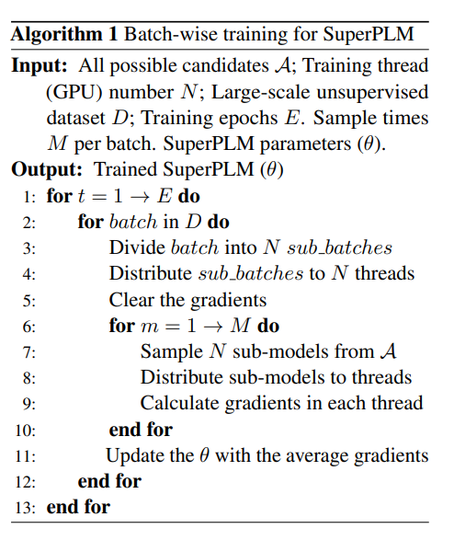
One-shot Learning for SuperPLM

Slide 15
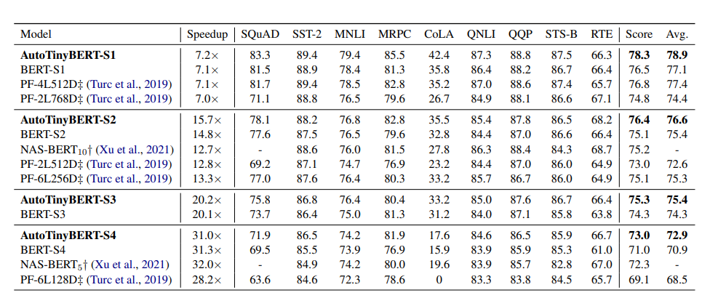
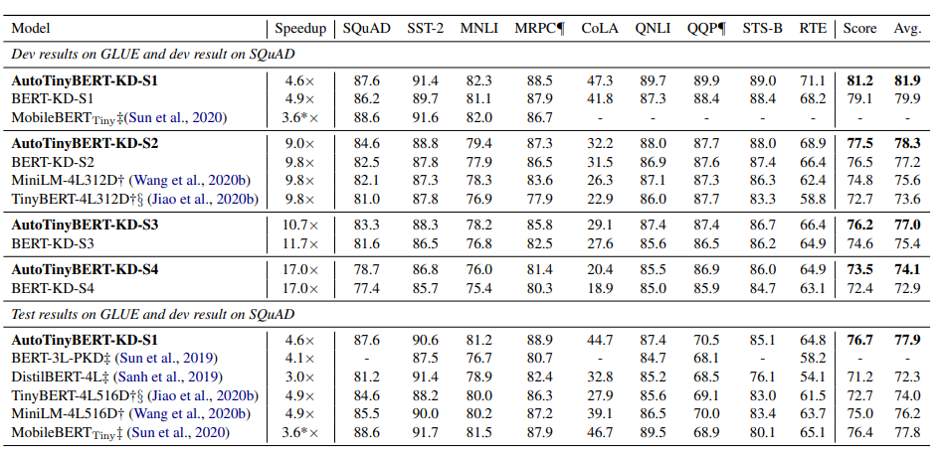
Experiment

Slide 16
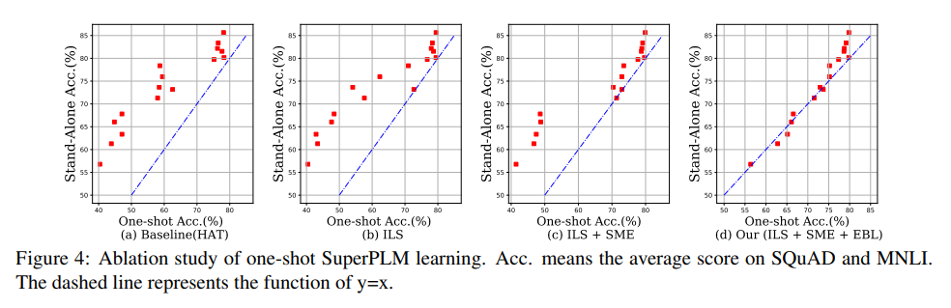
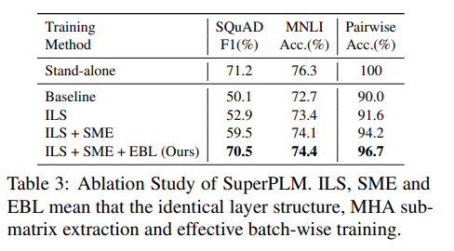
Ablation Study of one-shot learning

Slide 17
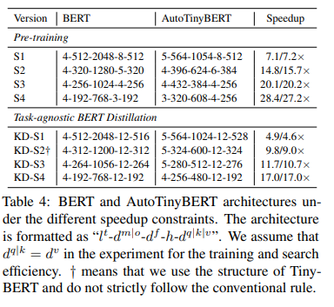



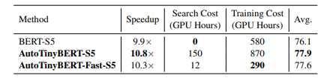
Fast Development of Efficient PLM
1
the candidates of the same layer number seem to have similar shapes. Assume that they have similar performance.
Only need to test one architecture at each layer number and choose the best one as

Slide 18
THANK YOU!

